Slide 1
HR & PEOPLE ANALYTICS · DATA STORYTELLING PROJECT
Employee Performance
& Productivity Analytics
What 100,000 employee records reveal about pay, performance, attrition
and the HR myths the data dismantles.
Presented by MOHAMMAD SHADAB
Data Analyst · Python · SQL · Power BI · Excel
100,000 Employees
9 Departments
2014 – 2024
21 Charts · 4 Dashboard Tabs
Employee Performance & Productivity Analytics · Mohammad Shadab
01

Slide 2
ROADMAP
What We'll Cover Today
01
02
Workforce Overview
Compensation
How the company grew: headcount balance, the 2014–2024 hiring engine, tenure mix
Job title vs education vs gender vs experience — what actually sets pay
03
04
Performance
Attrition & Satisfaction
Ratings, training and promotions — and the noise hiding inside them
Why 10,010 people left — and why satisfaction never warned us
Employee Performance & Productivity Analytics · Mohammad Shadab
02

Slide 3
THE 30-SECOND STORY
If You Remember Only Three Things…
FINDING 01
FINDING 02
FINDING 03
Job title is the ONLY real pay lever
Attrition is a flat 10% — everywhere
Training & tenure don't drive results
Engineers & Managers earn ~$7.8K vs Technicians ~$4.5K — a 72% gap. Education moves pay 0.52%, gender ~0.2%.
Department, education, remote work and even satisfaction barely move it. Stayers rate 3.00; leavers 2.99.
Ratings are a uniform ~20K per score; training sits at 49.3–49.7 hrs at every rating. Correlations ≈ 0.00.
$6,403
10.01%
r = 0.51
3.00 / 5
AVG MONTHLY SALARY
OVERALL ATTRITION
PERFORMANCE ↔ SALARY
AVG PERFORMANCE
THE TWIST
Almost every relationship in 100,000 rows is statistically zero — HR levers are disconnected from outcomes. Strategy should follow role architecture, not folklore.
Employee Performance & Productivity Analytics · Mohammad Shadab
03

Slide 4
01
SECTION ONE
Workforce Overview
How the company grew, where people sit, and what the hiring engine looked like over a decade.
Employee Performance & Productivity Analytics · Mohammad Shadab
04

Slide 5
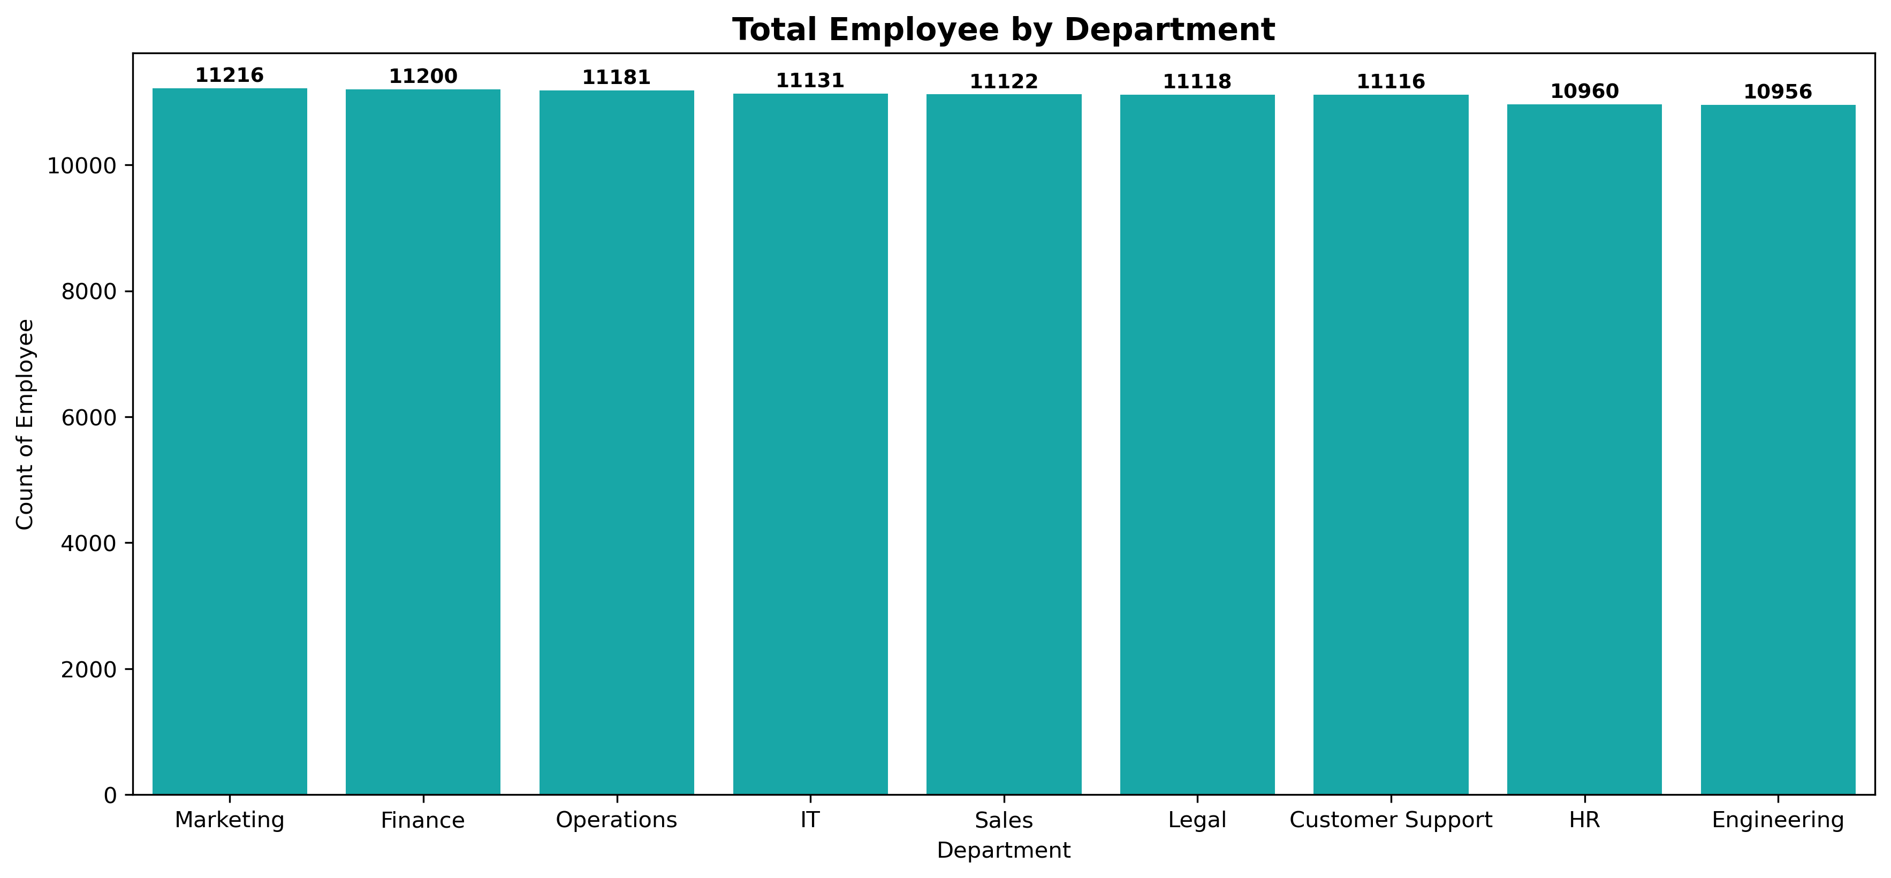
WORKFORCE OVERVIEW
Headcount by Department
BALANCED BY DESIGN
Nine teams, one even spread
Marketing is the largest team (11,216); Engineering the smallest (10,956) — a difference of just 260 people (2.3%) across 100,000 employees. No department is staffed like a flagship or starved; workforce planning has been deliberately even-handed.
Employee Performance & Productivity Analytics · Mohammad Shadab
05

Slide 6
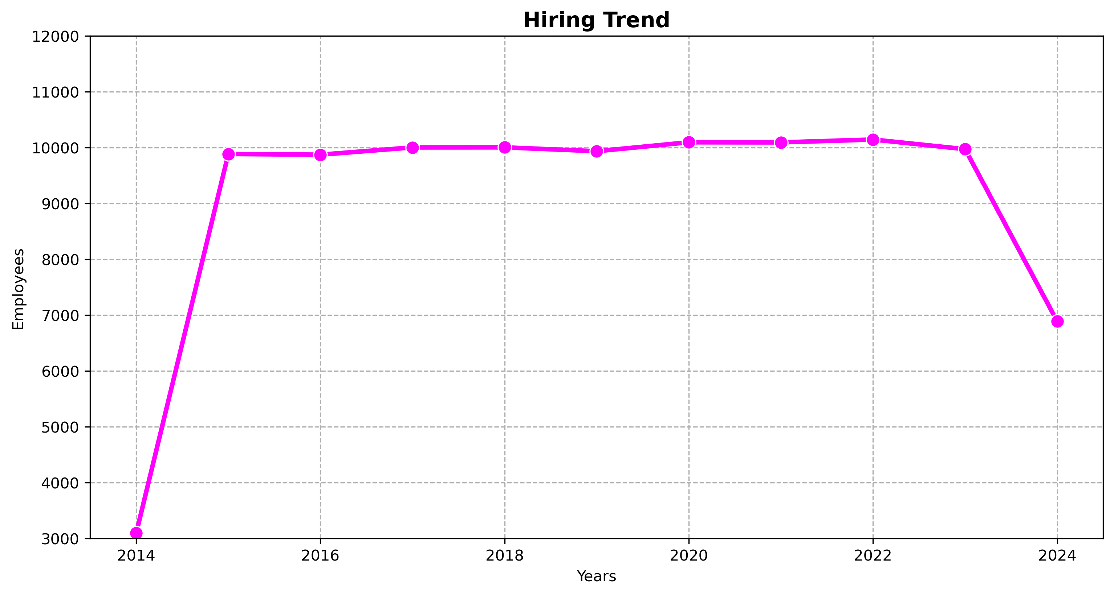
WORKFORCE OVERVIEW
Hiring Trend, 2014–2024
RAMP · PLATEAU · SHOCK
The 2024 cliff is the story
2014→2015 headcount triples (3.1K→9.9K) in the build-out year; 2015–2023 is a stable plateau ~10K hires/year peaking at 10.1K in 2022. In 2024 hiring collapses to 6.9K — a 31% cut and the decade's only real shock, worth a post-mortem.
Employee Performance & Productivity Analytics · Mohammad Shadab
06

Slide 7
02
SECTION TWO
Compensation
Who gets paid what — and why almost everything people THINK drives salary… doesn't.
Employee Performance & Productivity Analytics · Mohammad Shadab
07

Slide 8
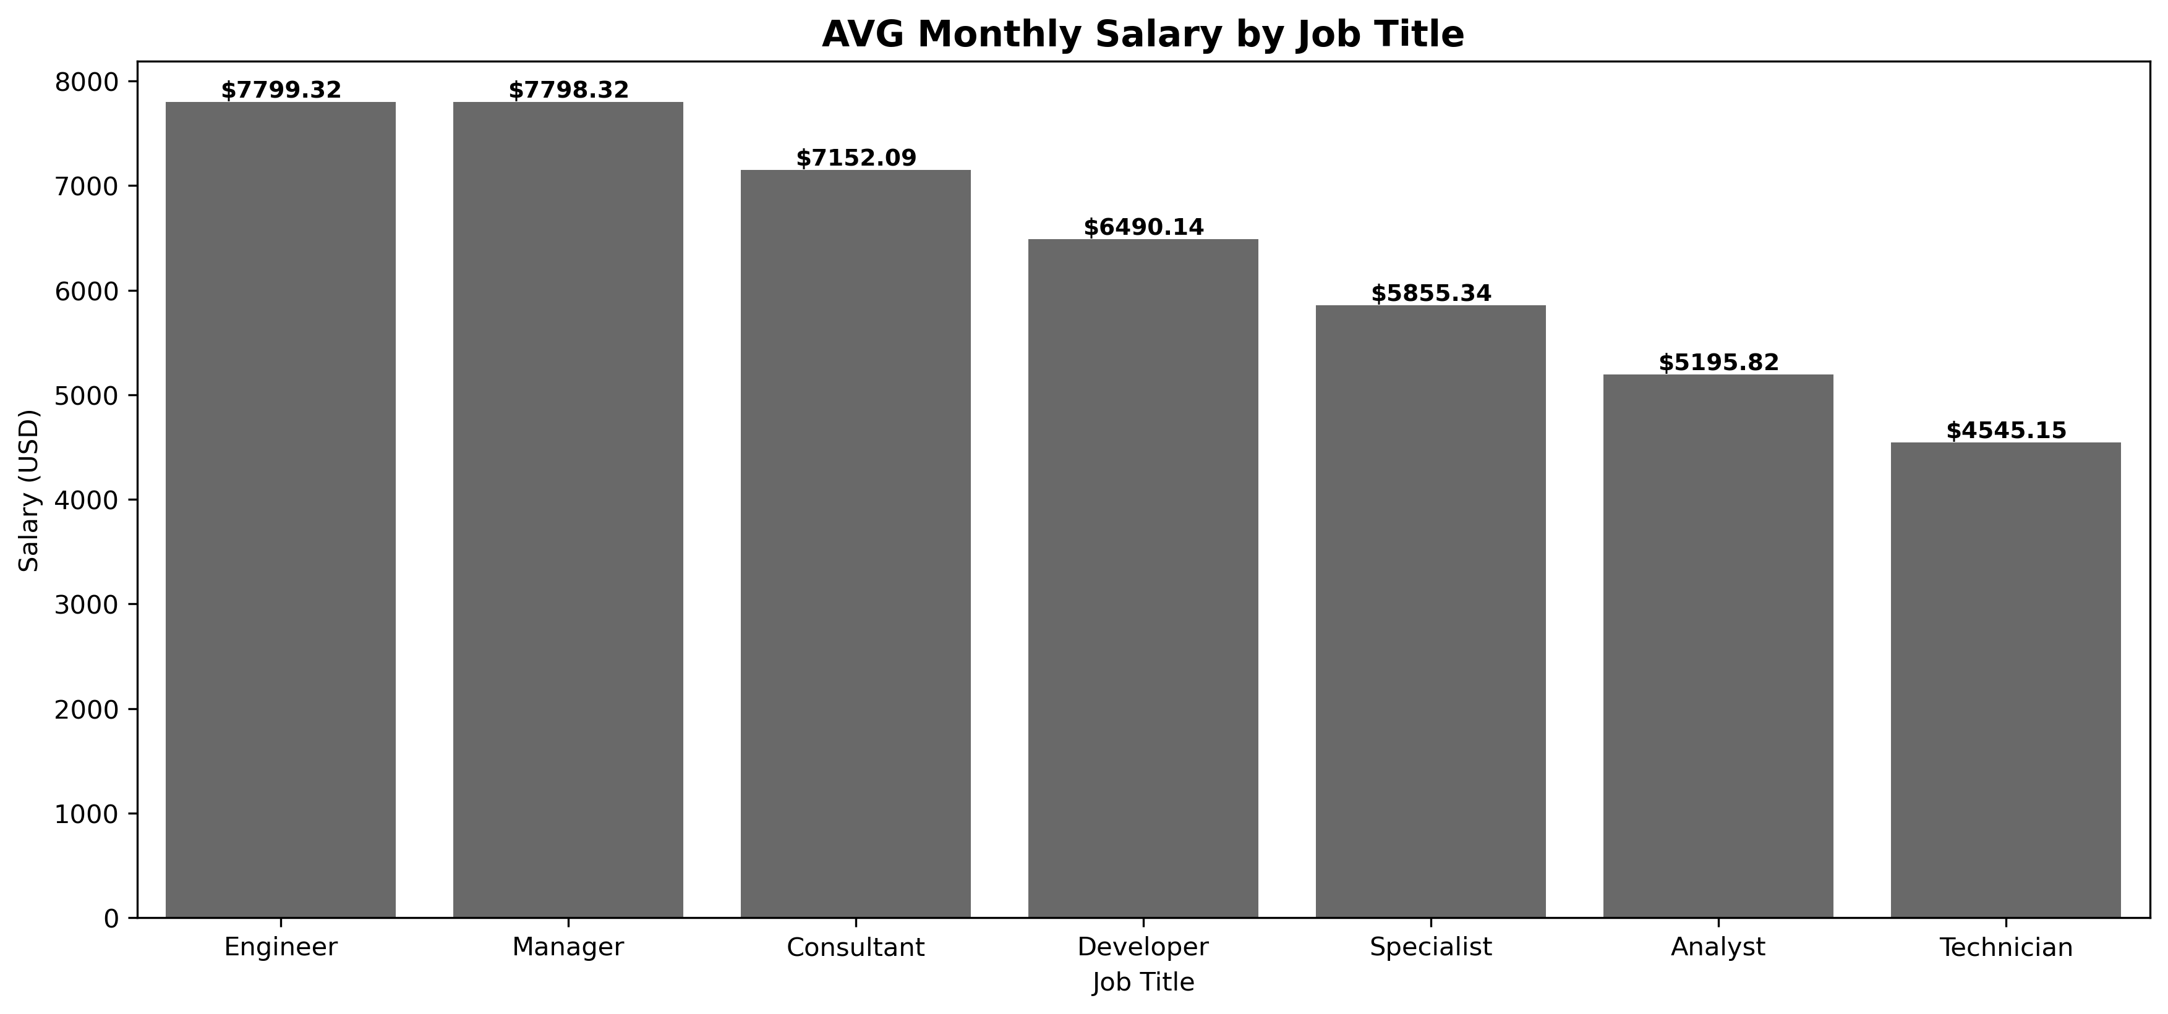
COMPENSATION
Average Salary by Job Title — the 72% Gap
ROLE IS THE PAY SYSTEM
A $3,254 monthly chasm
Engineers/Managers average $7,799 while Technicians average $4,545 — a 72% gap. Consultant ($7,152) and Developer ($6,490) sit mid-scale; Specialist ($5,855) and Analyst ($5,196) below. Job levelling is THE dial to turn for fairness and retention.
Employee Performance & Productivity Analytics · Mohammad Shadab
08

Slide 9
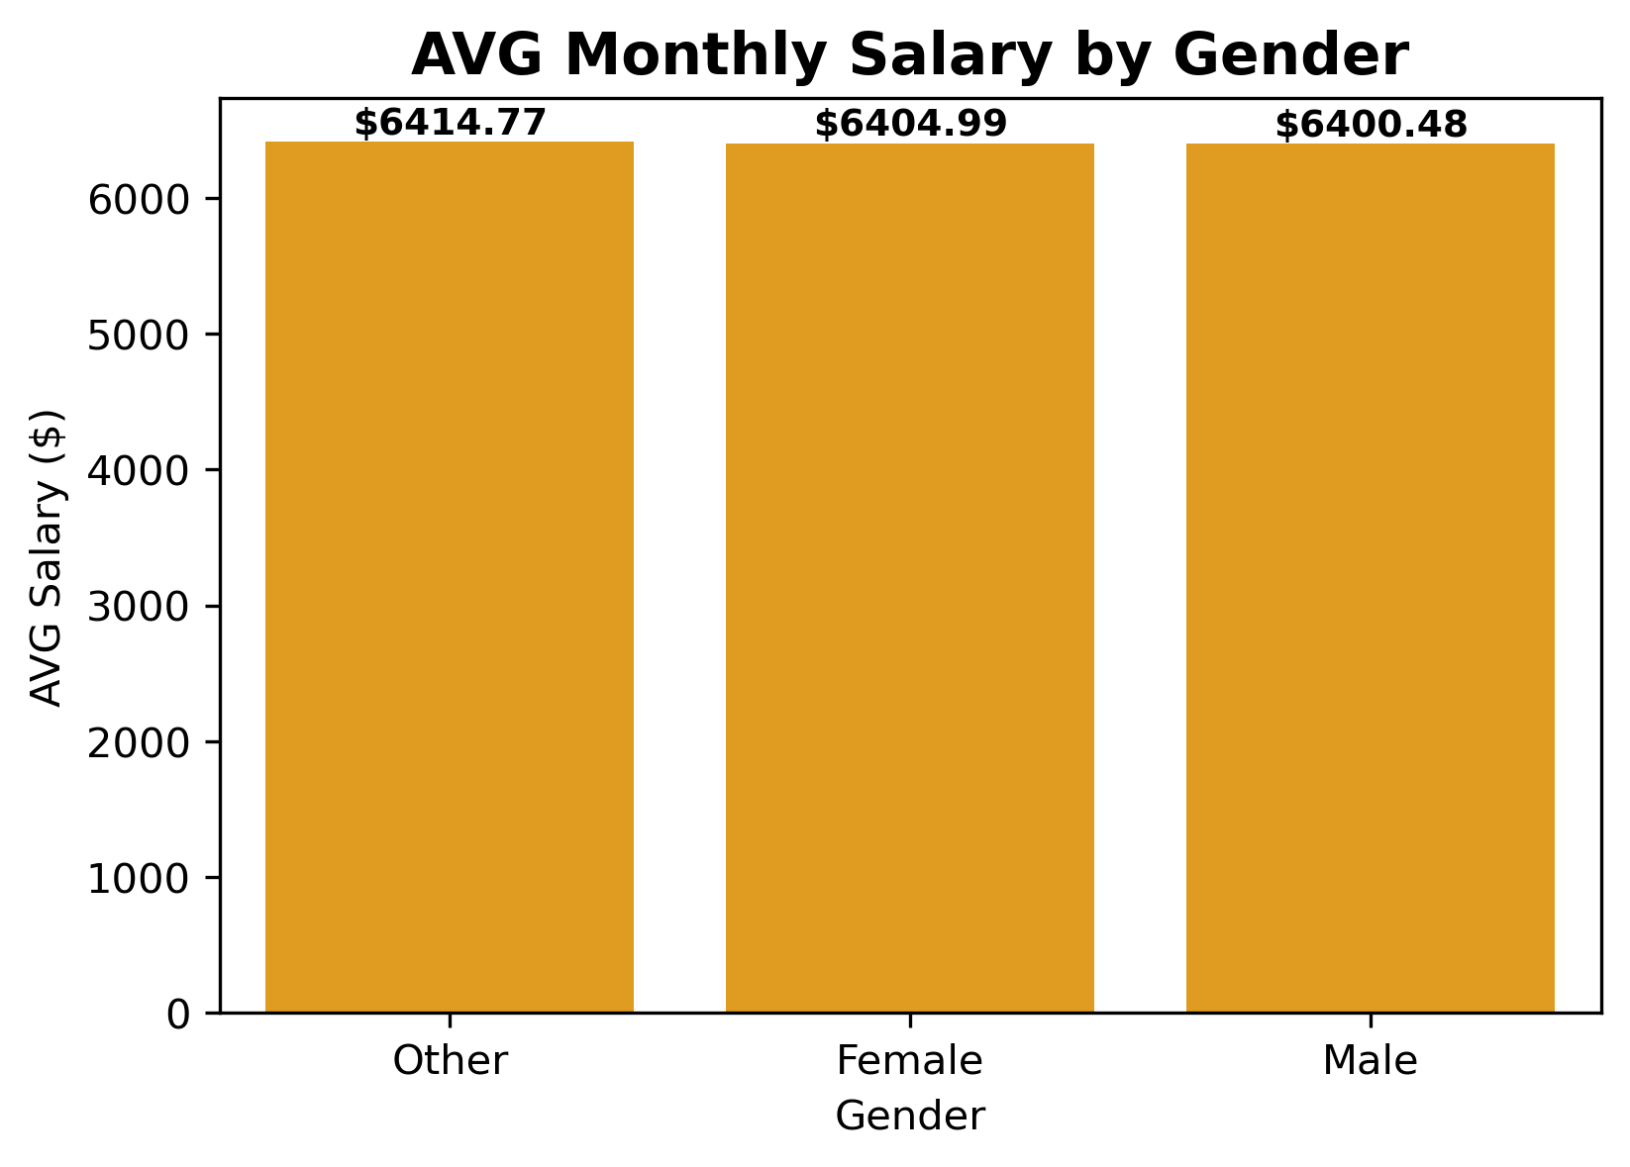
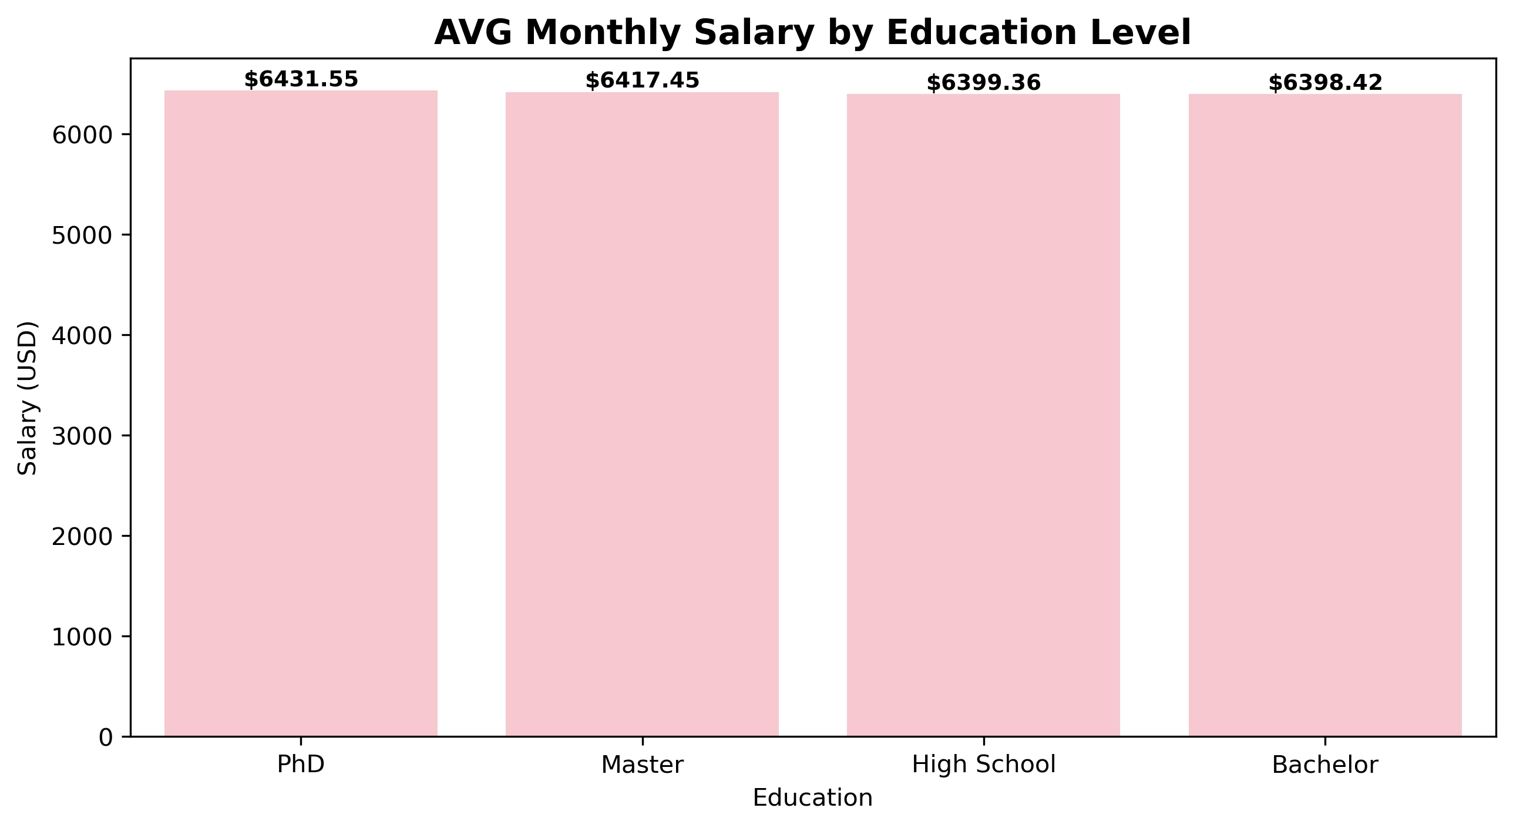
COMPENSATION
The Great Equalisers: Education & Gender
MYTH BUSTED — AND A WIN TO PROTECT
A PhD earns $6,431 vs a Bachelor's $6,398 — about $1/day more; education is table stakes, not a pay ladder. Gender pay gap ≈ 0.2% ($6,400–$6,415 across groups): pay equity is essentially achieved — protect it in every audit.
Employee Performance & Productivity Analytics · Mohammad Shadab
09

Slide 10
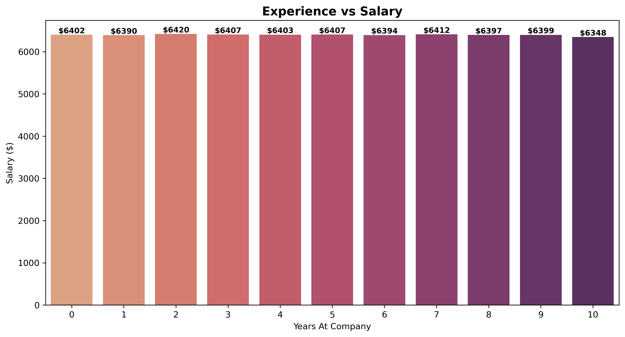
COMPENSATION
Experience vs Salary: The Flatline
LOYALTY ISN'T PRICED IN
Year 10 earns the least
Year 0 earns $6,402; year 10 earns $6,348 — the most tenured cohort actually earns the LEAST, and the whole 11-year range is ~$70 wide. Without time-based progression, long-tenure staff have every reason to look elsewhere; tenure increments are a cheap retention fix.
Employee Performance & Productivity Analytics · Mohammad Shadab
10

Slide 11
03
SECTION THREE
Performance
Ratings, training and promotions — and why the performance machine looks suspiciously like a random number generator.
Employee Performance & Productivity Analytics · Mohammad Shadab
11

Slide 12
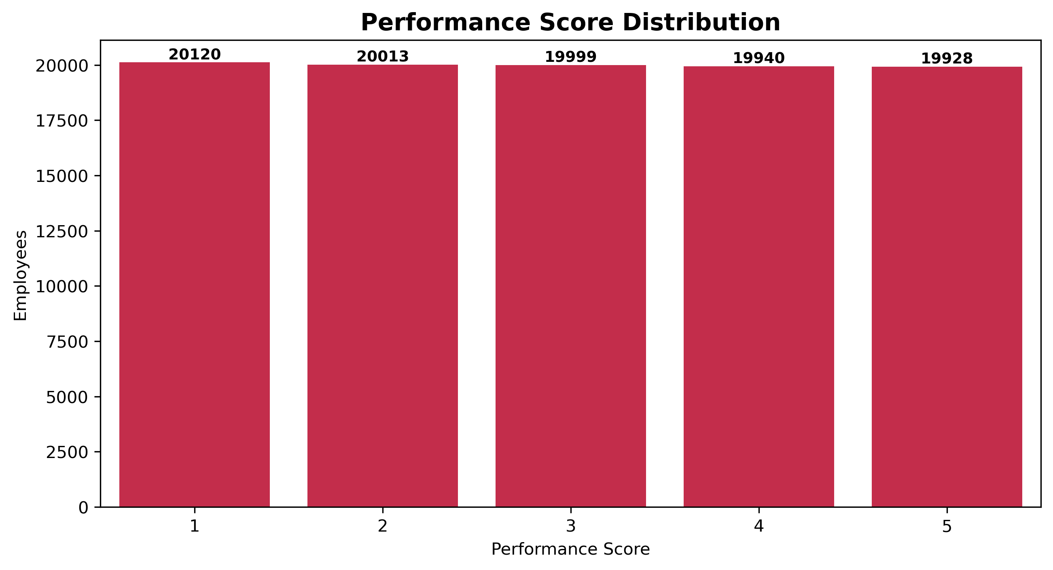
PERFORMANCE
Performance Score Distribution
A WHITE-PICKET FENCE
20,000 people in every bucket
20,120 / 20,013 / 19,999 / 19,940 / 19,928 employees at scores 1–5 — just 192 people between the best and worst groups. Real reviews produce stars and laggards; a perfectly uniform spread says ratings carry almost no information.
Employee Performance & Productivity Analytics · Mohammad Shadab
12

Slide 13
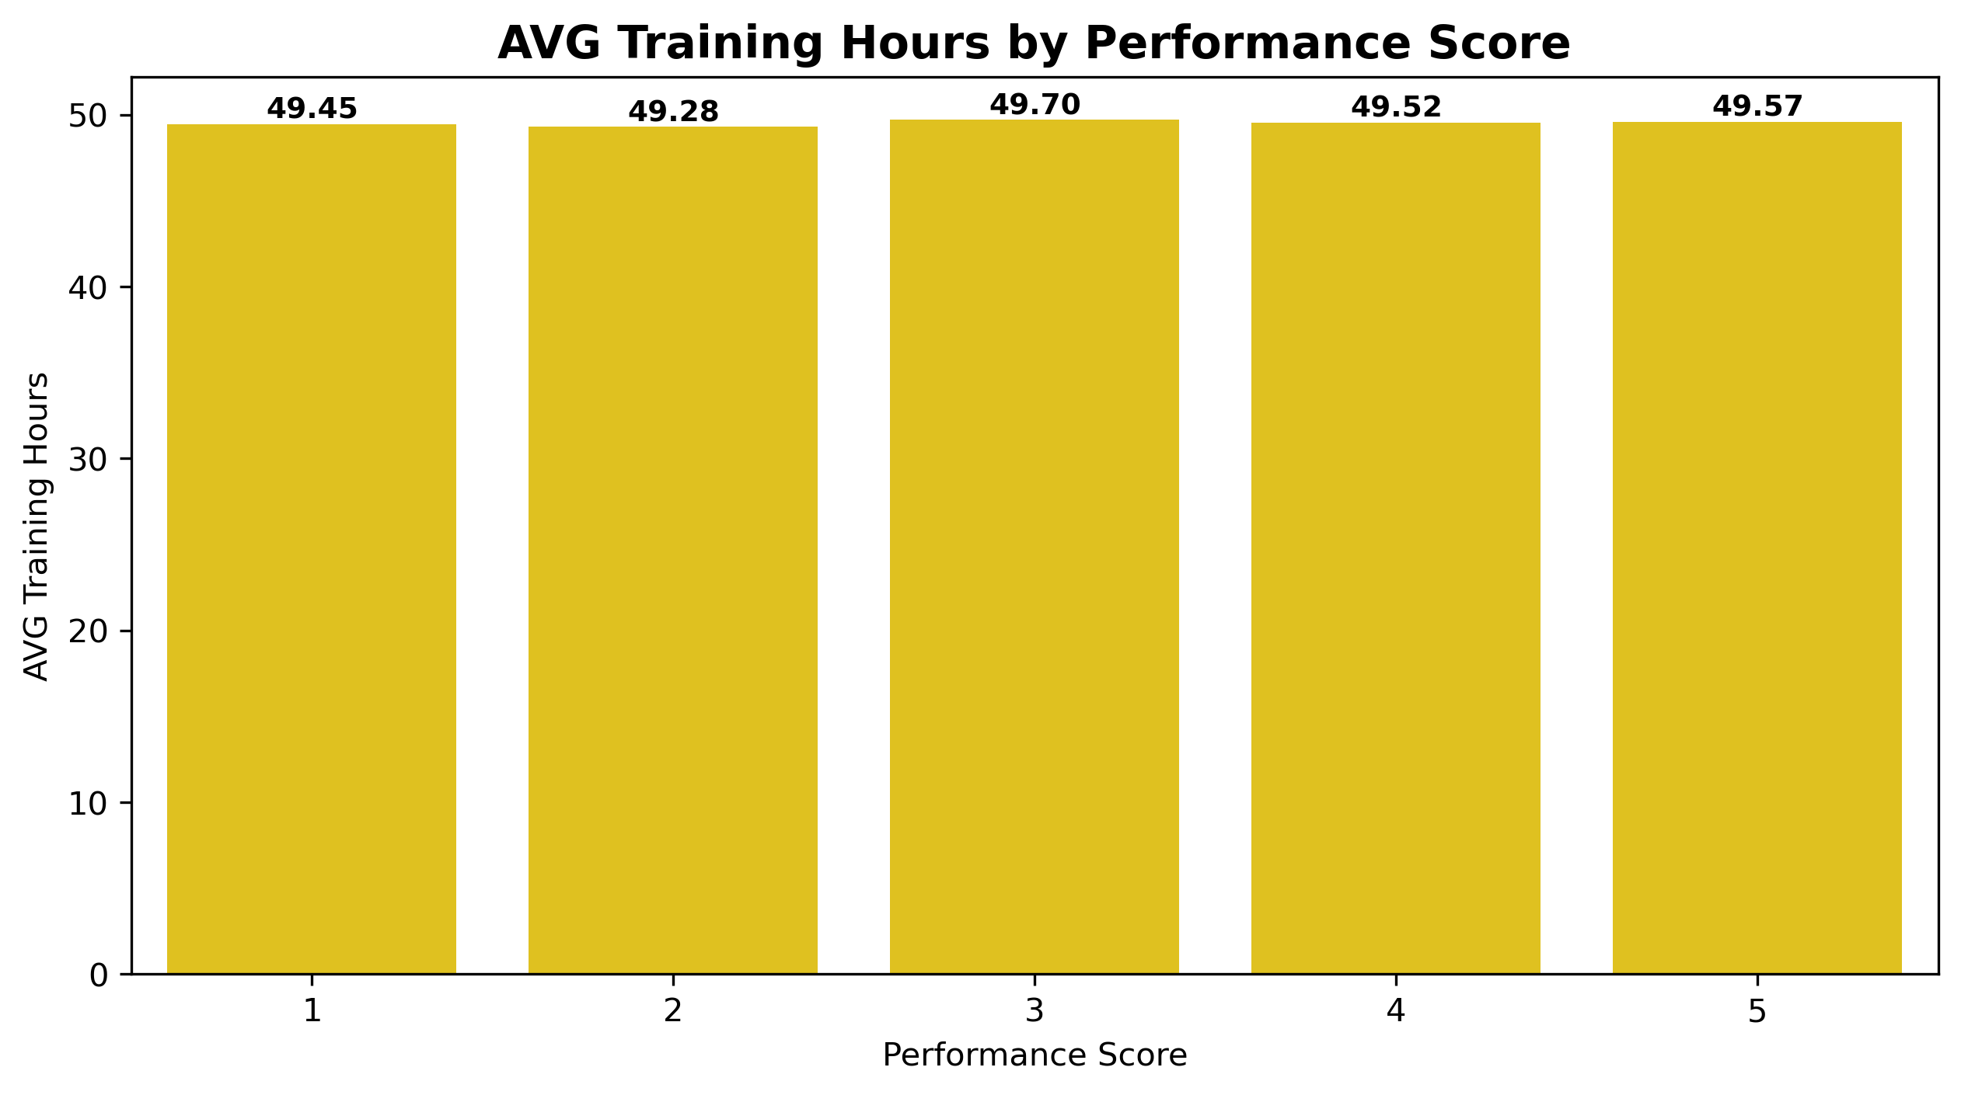
PERFORMANCE
Training Hours vs Performance Score
ENTITLEMENT, NOT INTERVENTION
A 25-minute range all year
Score 1 receives 49.45 training hours; score 5 receives 49.57 — a 25-MINUTE difference across a full year. Promotions don't move ratings either (3.01 with zero promotions vs 2.99 with 1–2). Training should be targeted at low performers and measured for lift.
Employee Performance & Productivity Analytics · Mohammad Shadab
13

Slide 14
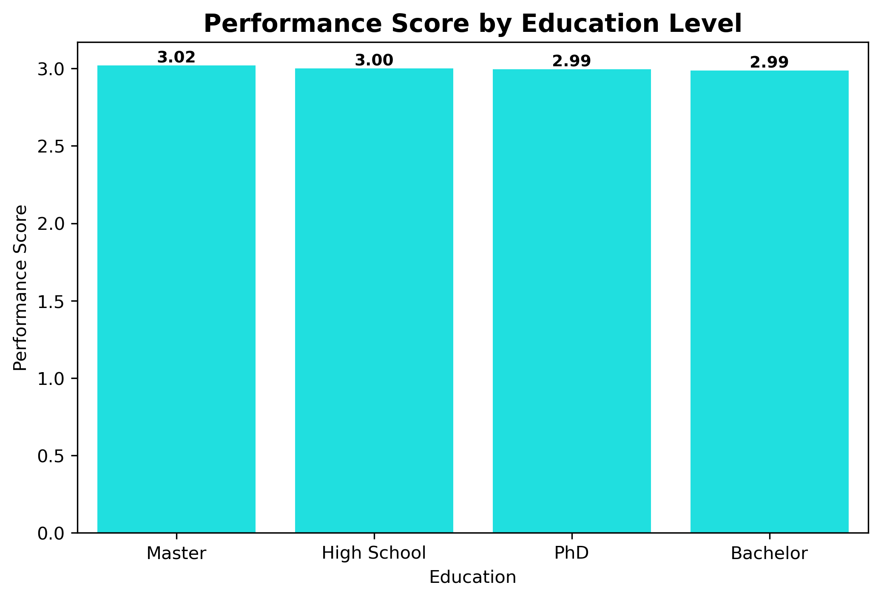
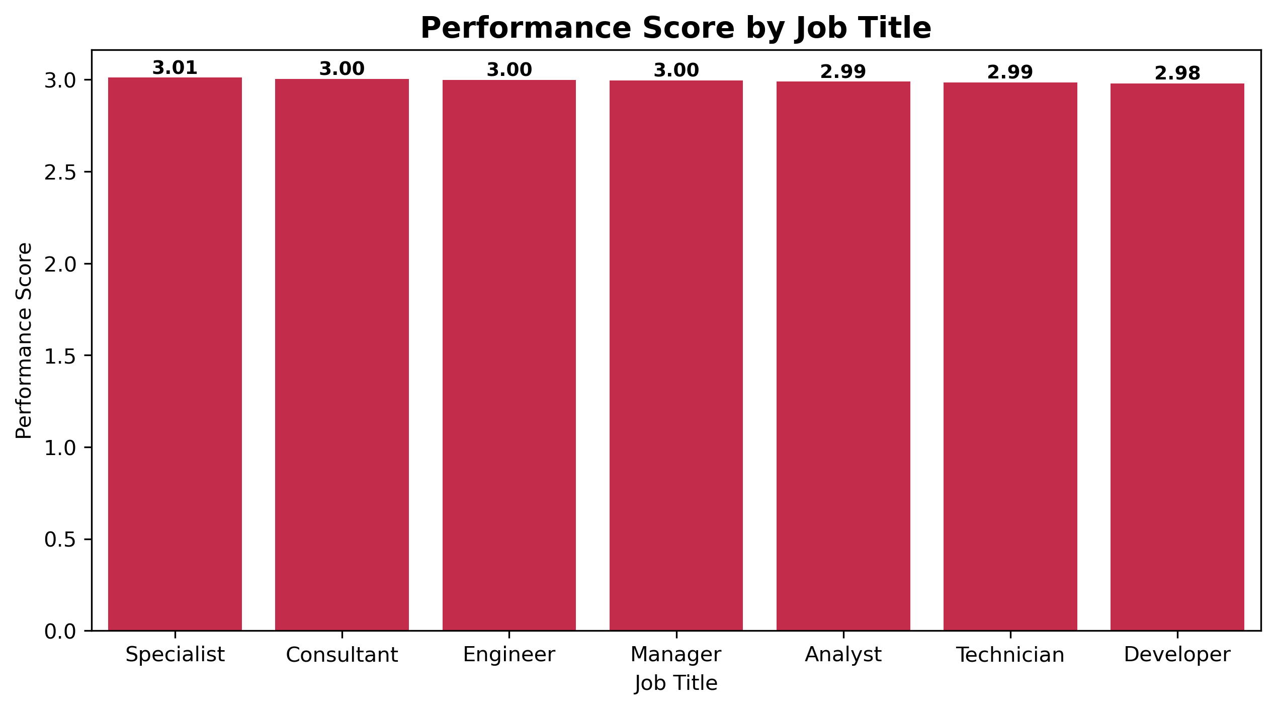
PERFORMANCE
Ratings by Job Title & Education — Everything Is a 3.00
UNDIFFERENTIATED ACROSS THE BOARD
Every job title scores 2.98–3.01, every education level 2.99–3.02, every gender 2.99–3.00. Yet Performance ↔ Salary is the dataset's ONLY real correlation (r = 0.51): uninformative ratings are driving pay. Reviews need evidence anchors and manager calibration.
Employee Performance & Productivity Analytics · Mohammad Shadab
14

Slide 15
04
SECTION FOUR
Attrition & Satisfaction
10,010 people left. The data can barely tell them apart from the 89,990 who stayed — and that's the most important finding of all.
Employee Performance & Productivity Analytics · Mohammad Shadab
15

Slide 16
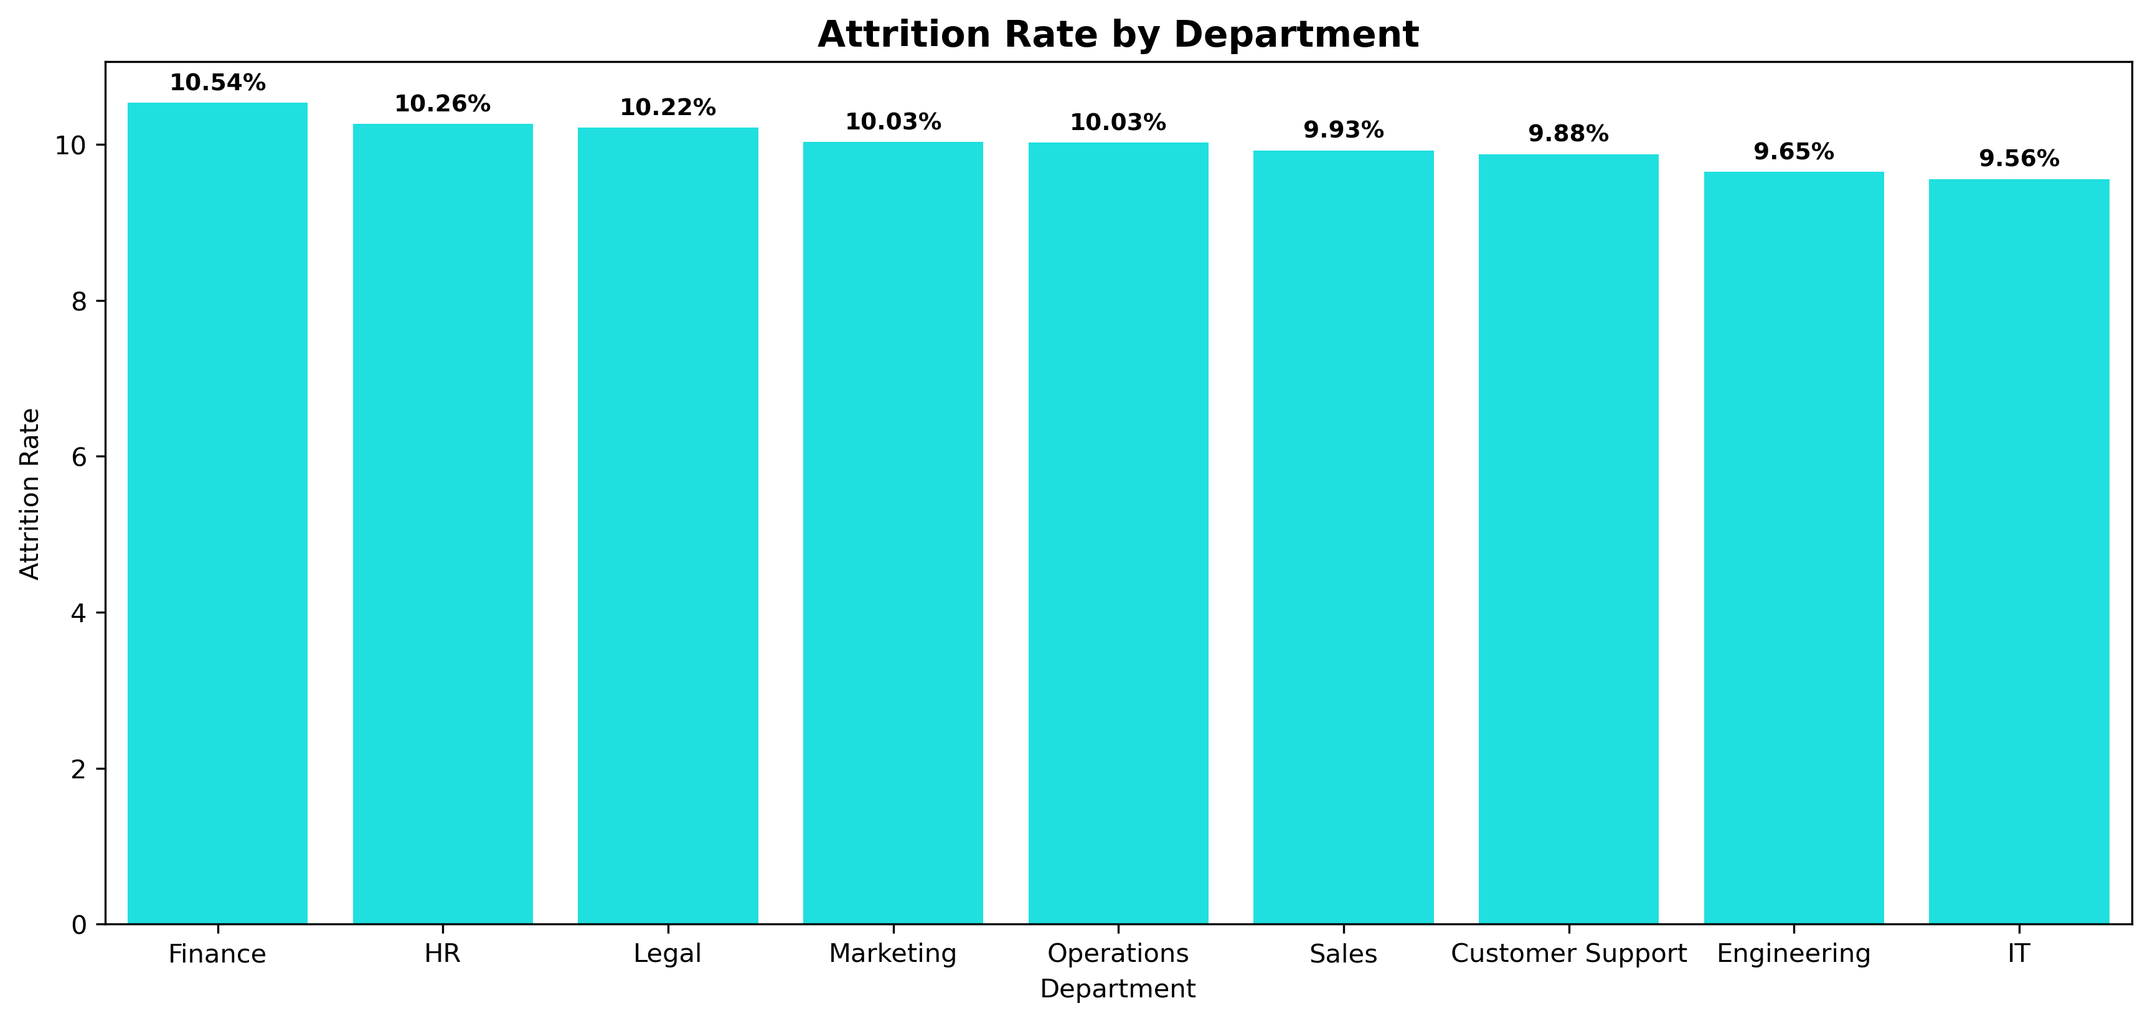
ATTRITION & SATISFACTION
Attrition Rate by Department
A COMPANY-WIDE CONSTANT
Turnover isn't local
Finance leads at 10.54%, IT is lowest at 9.56% — the entire 9-department range is under 1 percentage point. Education is flat too (PhD 10.31% → Master 9.98%). Turnover points to systemic causes, not 'bad managers' — local fixes won't move a global number.
Employee Performance & Productivity Analytics · Mohammad Shadab
16

Slide 17
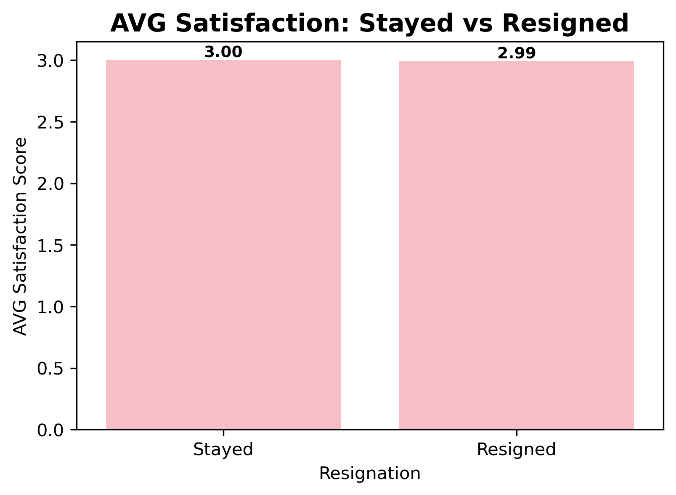
ATTRITION & SATISFACTION
The Satisfaction Paradox
THE EXIT SIGNAL IS MISSING
Stayed 3.00 vs Resigned 2.99
A 0.01 difference on a 5-point scale: the people who walked out were statistically exactly as happy as those who stayed. Satisfaction surveys predict ZERO attrition. Replace passive mood scoring with intent-to-stay pulses, manager-quality signals and compa-ratio flags.
Employee Performance & Productivity Analytics · Mohammad Shadab
17

Slide 18
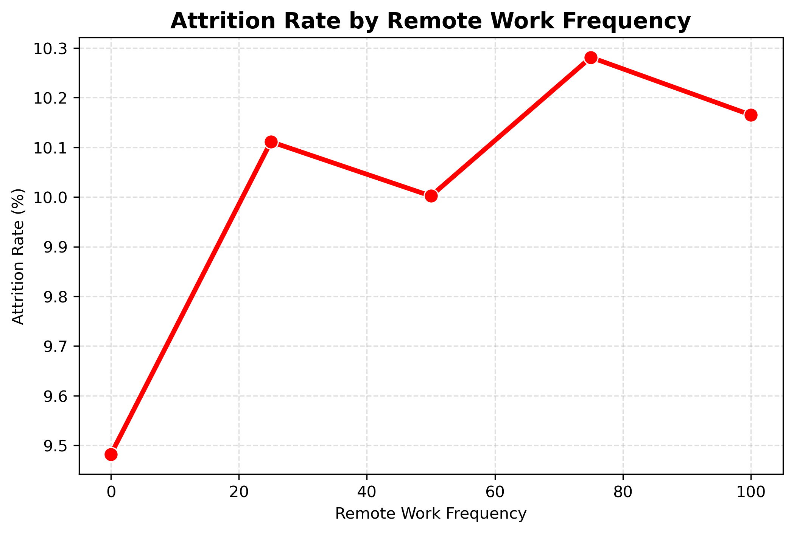
ATTRITION & SATISFACTION
Attrition vs Remote Work Frequency
A TUNING KNOB, NOT A DRIVER
0.8 points from end to end
Fully in-office (0%) = 9.48% attrition; 75% remote = 10.28% peak; fully remote = 10.17%. The whole curve spans just 0.8 points — remote policy isn't the cause. But paired with the 2024 hiring cliff, hybrid-heavy teams deserve a closer qualitative look.
Employee Performance & Productivity Analytics · Mohammad Shadab
18

Slide 19
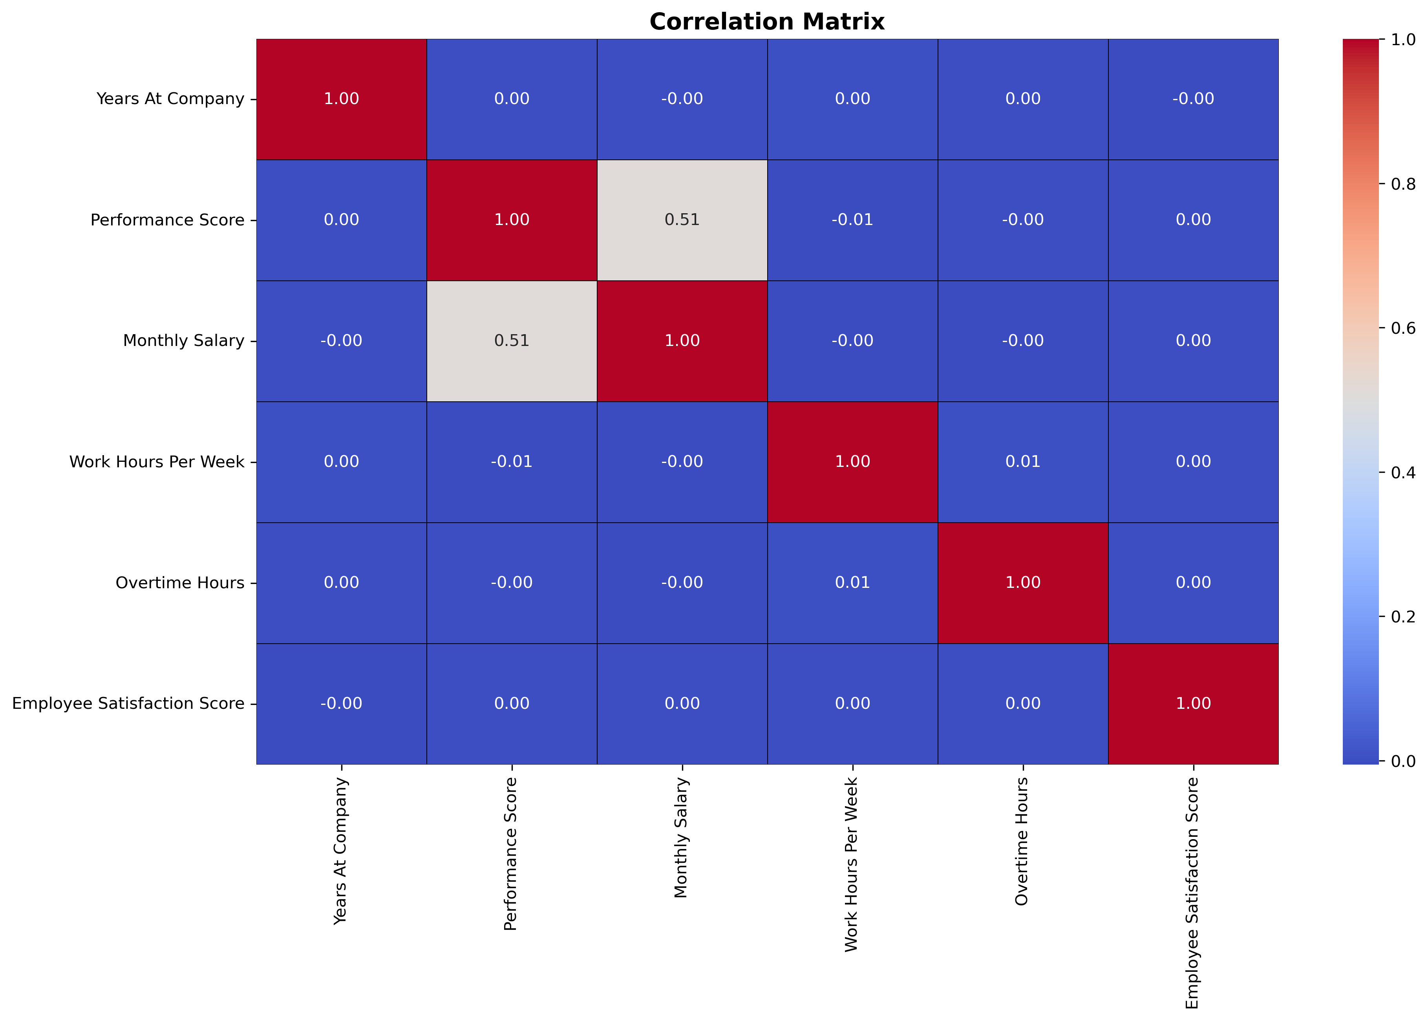
THE STATISTICAL HEART
Correlation Matrix: One Signal in a Sea of Zeroes
R = 0.51 IS THE WHOLE GAME
One relationship survives
Across 15 numeric features, Performance ↔ Salary (0.51) is the only correlation that isn't noise. Training↔performance, tenure↔salary, satisfaction↔attrition and hours↔overtime all round to 0.00. A dashboard that finds 'nothing relates' is not a failed analysis — it's a diagnosis: people processes are running unmeasured. That's where strategy starts.
Employee Performance & Productivity Analytics · Mohammad Shadab
19

Slide 20
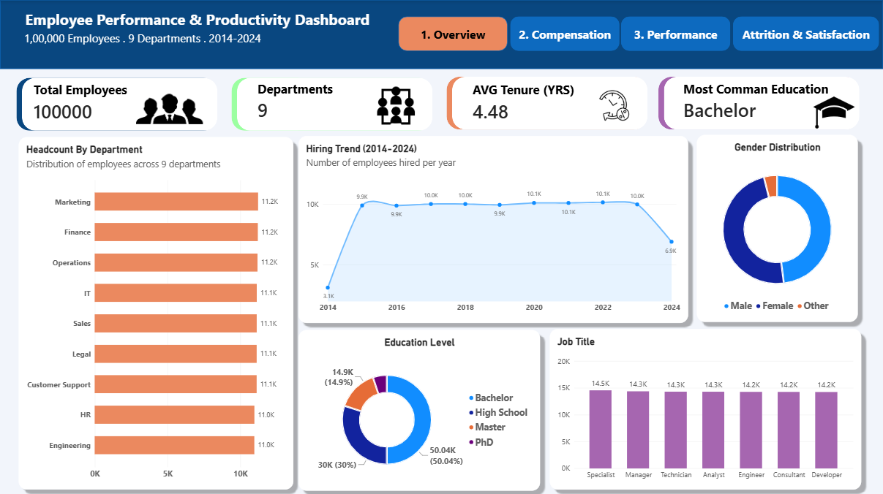
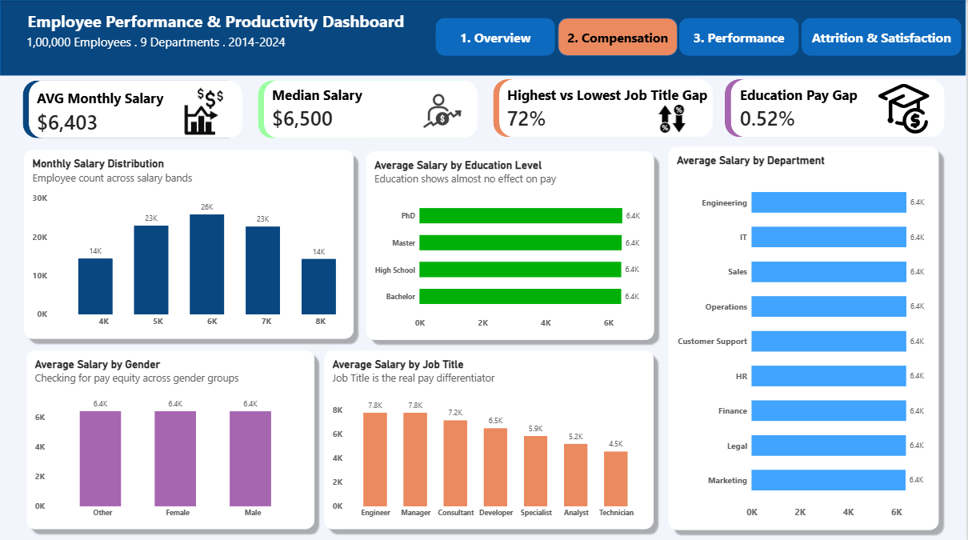
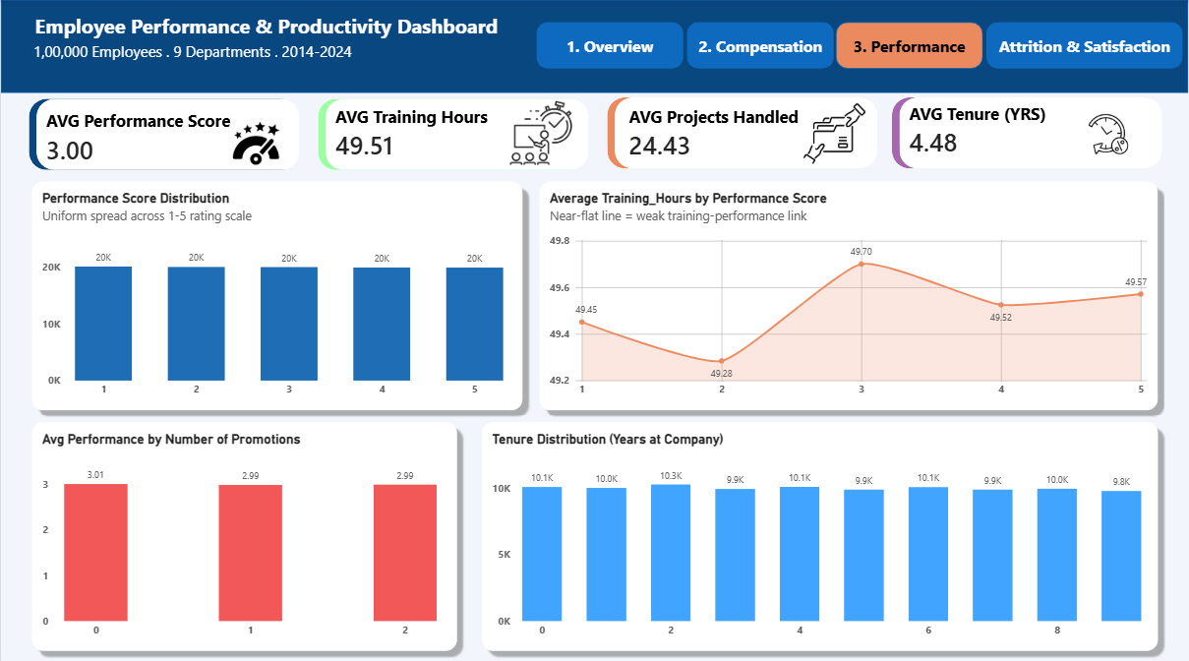
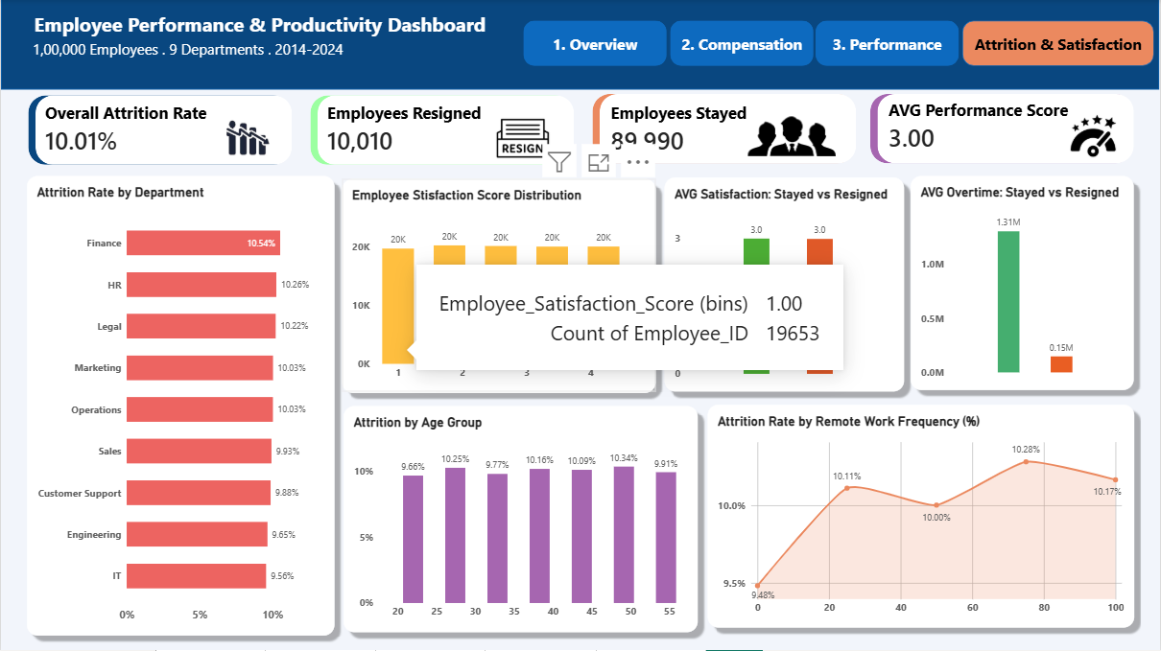
THE DELIVERABLE
Interactive Dashboard — Four Tabs
Tab 1 · Overview — headcount, hiring, demographics
Tab 2 · Compensation — pay across role, education, gender
Tab 3 · Performance — ratings, training, tenure
Tab 4 · Attrition & Satisfaction — turnover drivers
Employee Performance & Productivity Analytics · Mohammad Shadab
20

Slide 21
MYTHS VS MATH
What HR Believes vs What 100,000 Records Show
The belief | The evidence | Verdict
Higher education = higher pay | PhD $6,431 vs Bachelor $6,398 | BUSTED · 0.52%
More experience = higher pay | Year 0 $6,402 · Year 10 $6,348 | BUSTED · flat
Training boosts performance | 49.28–49.70 hrs at every rating | BUSTED · 25-min range
Unhappy people quit | Stayed 3.00 vs Resigned 2.99 | BUSTED · 0.01
Remote workers leave more | 9.48% in-office vs 10.28% at 75% | MOSTLY BUSTED · 0.8 pt
Ratings differentiate people | ~20,000 employees in every score | BUSTED · uniform
Job title drives pay | $4,545 Technician → $7,799 Engineer | CONFIRMED · 72%
Pay is gender-equitable | $6,400–$6,415 across all groups | CONFIRMED · 0.2%
Employee Performance & Productivity Analytics · Mohammad Shadab
21

Slide 22
FROM INSIGHT TO ACTION
Six Recommendations for Leadership
1
Rebuild job levelling; publish bands
2
Add tenure-based progression
The 72% title gap is the whole pay story. Create visible paths for Technicians & Analysts stuck below $5.9K.
Year-10 staff earn the least ($6,348). Time-in-role increments beat replacing institutional knowledge.
3
Rebuild the churn early-warning system
4
Target training; stop rationing it equally
Satisfaction predicts nothing. Add intent-to-stay pulses, manager NPS, compa-ratio flags + a leavers model.
Aim hours at low performers and measure rating lift vs a control group.
5
Calibrate performance reviews
6
Investigate the 2024 signal
Uniform ratings drive pay (r = 0.51) yet say nothing. Use evidence anchors + calibration sessions.
31% hiring drop + peak hybrid attrition — run a post-mortem starting with Finance (10.54%).
Employee Performance & Productivity Analytics · Mohammad Shadab
22

Slide 23
Thank You
Questions & Discussion
The best dashboard doesn't just show data — it challenges beliefs.
One real lever (role), one win (pay equity), five metrics to rebuild.
Mohammad Shadab · Data Analyst
Python · SQL · Power BI · Excel
100,000 Employees · 9 Departments · 2014–2024
Employee Performance & Productivity Analytics · Mohammad Shadab
23

